Slide 1
Over-expression of BCl2 rescues muscle weakness in a mouse model of oculopharyngeal muscular dystrophy
As presented by: Timothy Heath
BIOL-506 Human Molecular Genetics
November 28, 2011
Janet E. Davies and David C. Rubinsztein

Slide 2
Overview of Presentation
Introduction to OPMD and apoptotic theories around it
Procedure and results
Significance of results
Critique and future potential
Question and answer session

Slide 3
Oculopharyngeal Muscular Dystrophy (OPMD)
Late-onset and progressive
Leads to proximal muscle weakness, and as the authors put it, “a severely impaired quality of life”
Normally inherited as autosomal dominant, although rare recessive forms have been seen as well

Slide 4
Cause of OPMD
Expansion mutation in the gene poly-(A) binding protein nuclear 1 (PABPN1)
Normal PABPN1 gene contains a 6 (GCG) codon repeat that encodes as the first 6 of a 10 unit stretch of alanines
In OPMD, this repeat is expanded between 8-13 (GCG) codons, leading to a 12-17 poly-alanine stretch

Slide 5
Molecular biology of OPMD
It is believed that the expanded alanine stretch gives the PABPN1 protein a toxic function not seen in the normal form
Forms aggregates of filaments in muscle fiber nuclei
Apoptosis is believed to be a leading cause of muscle weakness in OPMD

Slide 6
Links to apoptosis
Transgenic mice with OPMD show elevated levels of apoptosis
The drugs doxycycline, trehalose, and cystamine have been shown both to restore muscle strength due to OPMD and reduce apoptosis
Toxicity of PABPN1 was shown to be reduced by a homolog of BCL2
True connection is unclear

Slide 7
BCL2: Anti-apoptotic gene
B-cell CLL/lymphoma 2
Antagonizes the activation of pro-apoptotic proteins BCL2-associated X protein and BCL2 homologous antagonist/killer (BAX and BAK)

Slide 8
Hypotheses
Does apoptosis account for symptoms in OPMD? Evidence so far suggest it does.
Would over-expression of an anti-apoptotic gene, such as BCL2, rescue muscle weakness caused by OPMD?

Slide 9
Experimental subjects
Transgenic mice
OPMD mice with 17-alanine repeat in PABPN1 gene (A17 mice) under control of human skeletal actin promoter
Mice over-expressing human BCL2 gene (BCL2 mice) under control of myogenin regulatory factor 4
Heterozygous A17 mice were crossed with heterozygous BCL2 mice for experimental group

Slide 10
Testing
Strength testing by a grip strength meter
Vertical grip, elevation of the pelvis, and wire maneuvering (SHIRPA behavioral tests)
Analyzed with statistical methods
Testing over a period of 10 months

Slide 11
Results
A17 x BCL2 mice showed improved muscle strength and even rescue when compared to A17 mice
Over time, however, these results diminished and A17 x BCL2 mice began to seem similar to A17 mice

Slide 12
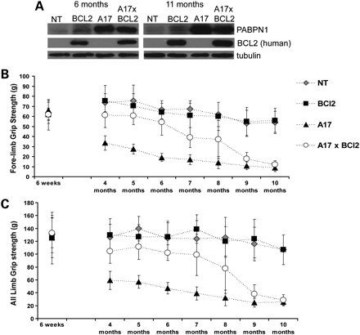
Results of grip-
strength test for
all mice over
10-month period

Slide 13
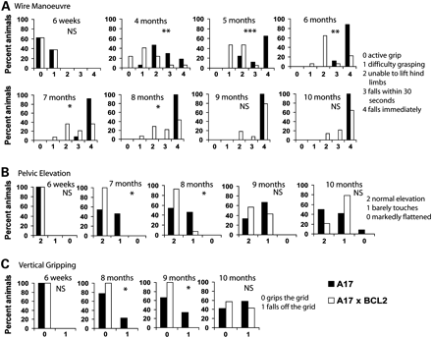

Slide 14
More results
A17 x BCL2 had higher weights than A17 mice, including in individual muscles
Histology from muscle sections showed fewer apoptotic cells in crossbred mice
Though rescue failed in later stages, anti-apoptotic markers were still present in late A17 x BCL2 mice.

Slide 15
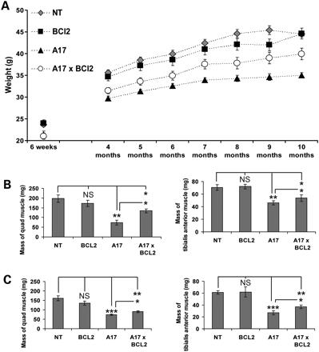

Slide 16
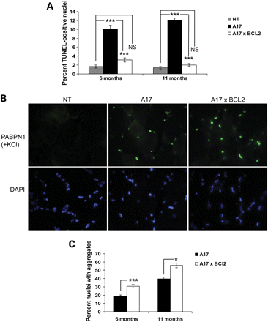
A: TUNEL-positive
nuclei counted by
histology. TUNEL-
positive indicates
apoptosis. B: Images
of labeled aggregates
C: Percent of nuclei
with aggregates
Note: reason for
increased aggregate
in A17xBCL2
believed to be due
to increased lifespan
of myofibres due to
BCL2 presence.

Slide 17
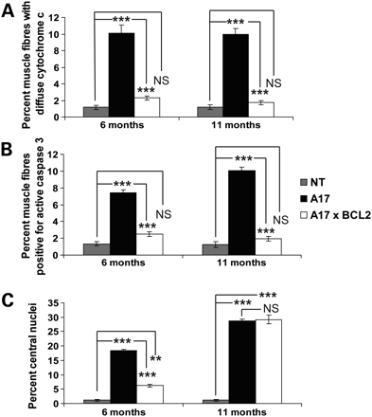
All of these are
apoptotic markers.
Higher percentages
correlate with more
apoptosis.

Slide 18
Significance and conclusions
BCL2 rescues muscle weakness caused by OPMD
Believed to block BAX, reduces A17 interaction on BAX
Apoptosis is likely a leading cause of muscle weakness in OPMD, but not the sole cause
It is also possible that other muscular dystrophies share this trait with OPMD
A new model for OPMD function may be suggested by these results.
Support for use of anti-apoptotic drugs in treatment of OPMD

Slide 19
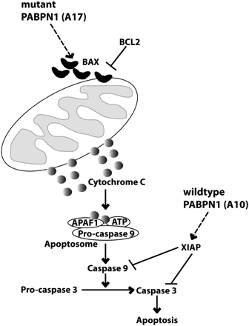
Author’s suggested
model of apoptosis in
OPMD function and
BCL2’s interaction
with system.

Slide 20
Critiques of the study
Study only mentioned A17 mice… could other forms of OPMD combined with BCL2 behave differently?
SHIRPA system scoring is scored by rankings and may not accurately reflect the true strengths of each mouse
Discourages BCL2 induction at end of paper due to difficulty in transient use for treatment (but supports more on use of drugs for treatment)

Slide 21
Future potential
Review of this function in other forms of muscular dystrophy
Apoptosis did not explain cell death in later months… what does?
Does prevention of apoptosis show treatment of symptoms in human OPMD patients?

Slide 22
Questions
?
I have answers!

